Slide 1

Spark Structured Streaming
Key concepts, development, testing and monitoring

Slide 2
Streams and Tables Theory

Slide 3
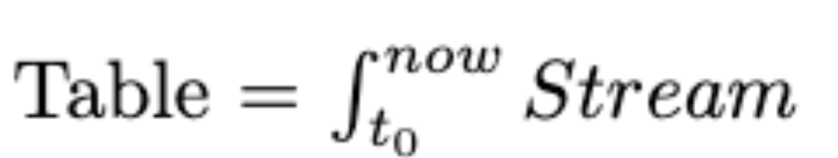
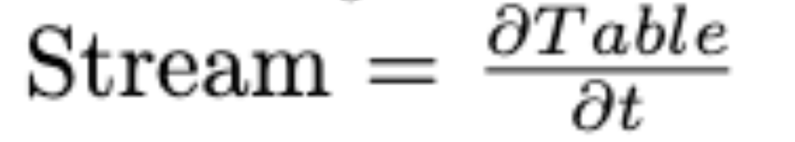
Streams theory – Tables and Streams
A stream can be considered a changelog of a table, where each data record in the stream captures a state change of the table.
A table can be considered a snapshot, at a point in time, of the latest record in a stream.
More formally

Slide 4
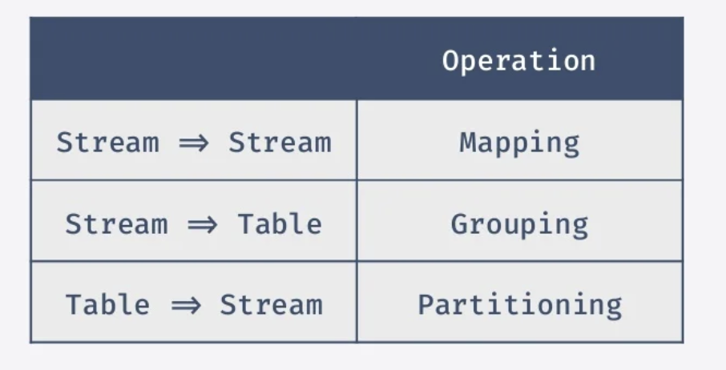
Streams theory – Tables and Streams

Slide 5
Tables and Streams
“semantically batch is really just a subset of streaming”

Slide 6
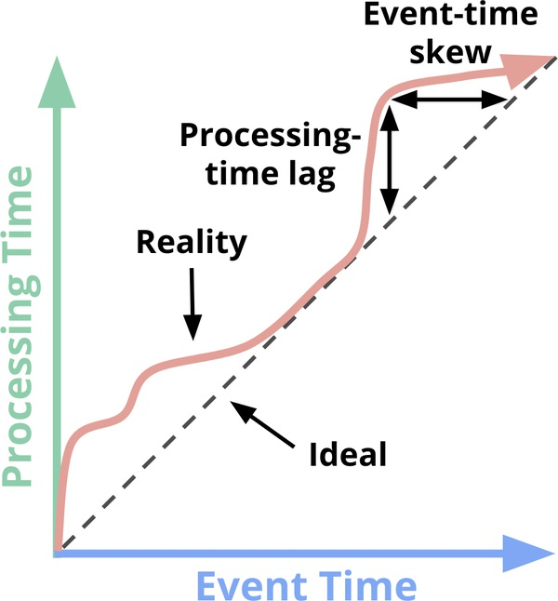
Time reasoning key concepts
Event time: This is the time at which events actually occurred.
Processing time: This is the time at which events are observed in the system.

Slide 7

Time reasoning key concepts
Triggers: Flow control mechanism for dictating when results should be materialized.
Windowing: Notion of taking a data source, and chopping it up along temporal boundaries into finite chunks for processing.

Slide 8

Correctness key concepts
Checkpoints: Persisted state over time to keep consistency in light of machine failures.
Watermarks: Temporal notions of input completeness in the event-time domain. They help dealing with late records.

Slide 9
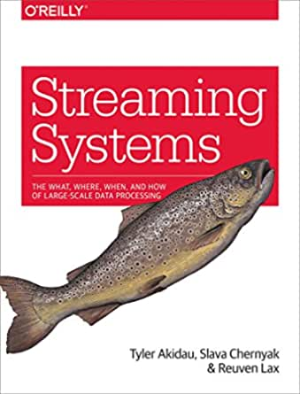

Enough theory
If you has loved streams theory you’ll find more here

Slide 10
Spark structured streaming
Development and testing

Slide 11
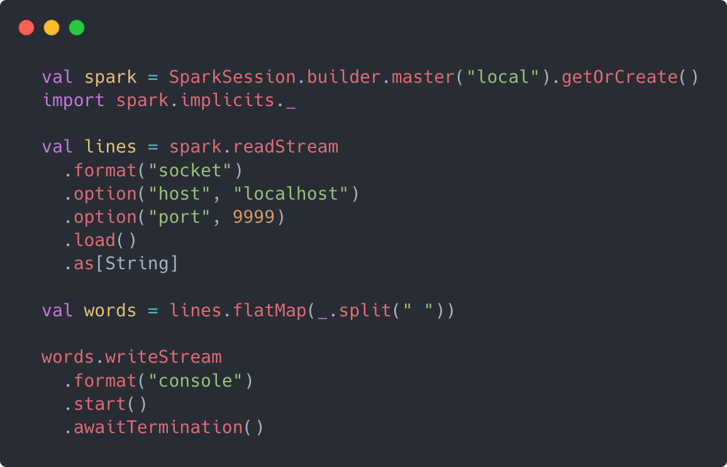
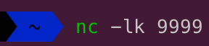
First Stream
Consum socket stream
Transform it
Write stream in the console
Test this app sending traffic to localhost:9999

Slide 12

First Stream
Can we test this streaming code?

Slide 13
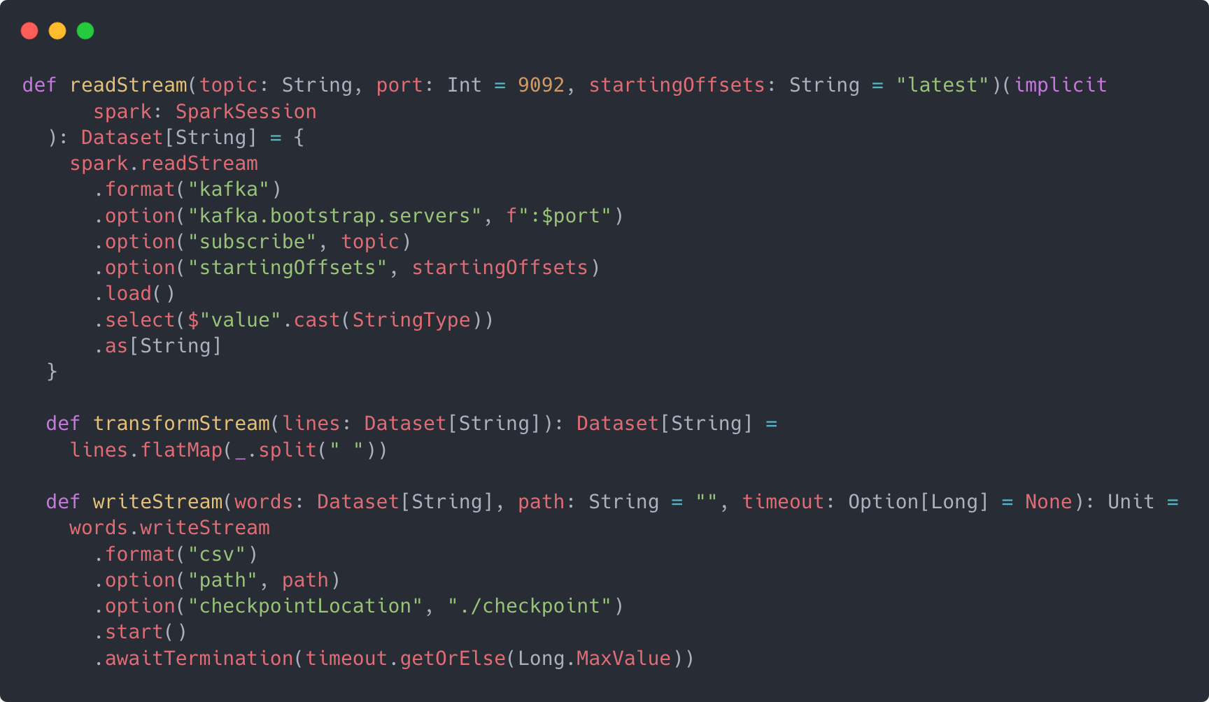
Kafa to FS Stream

Slide 14
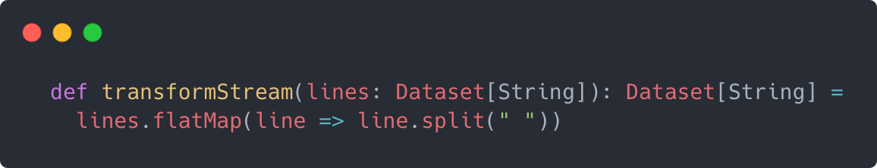

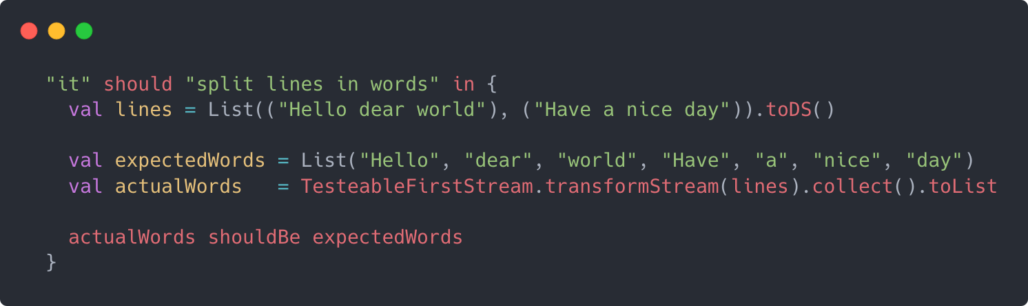
TeSTING transform
Structued streaming use the Datasets API
Transformations may be rehused between batch/streaming
Straightforward testing

Slide 15
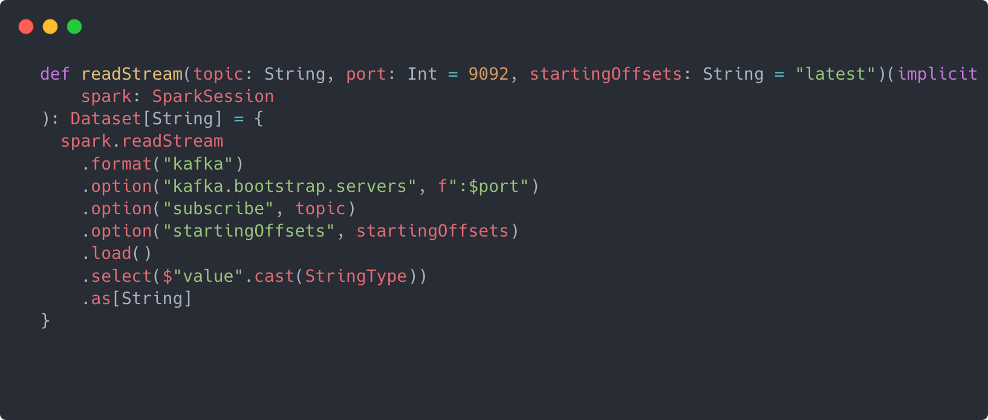
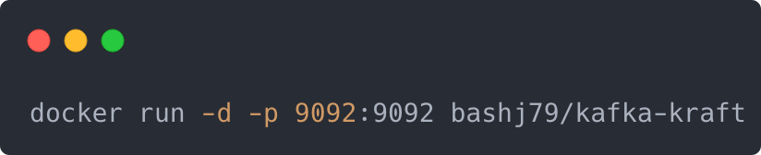
TeSTING READ STREAM
Need kafka docker
Using Kafka 3.0 with KRaft (Kafka without Zookeeper)

Slide 16
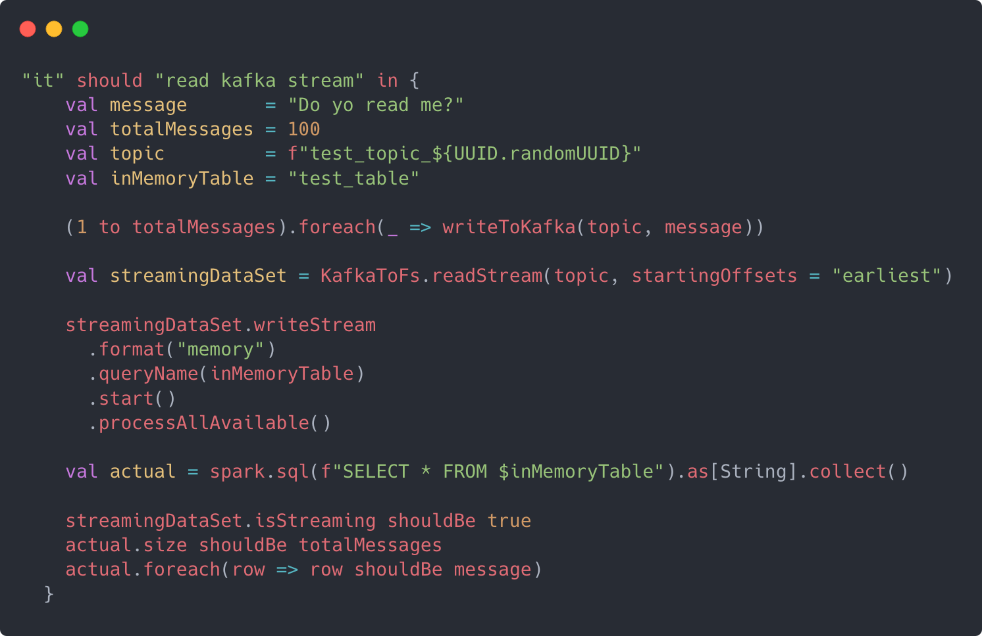
TeSTING READ STREAM
Streaming Datasets can’t be collected, they need to be written
To test read we need to write

Slide 17
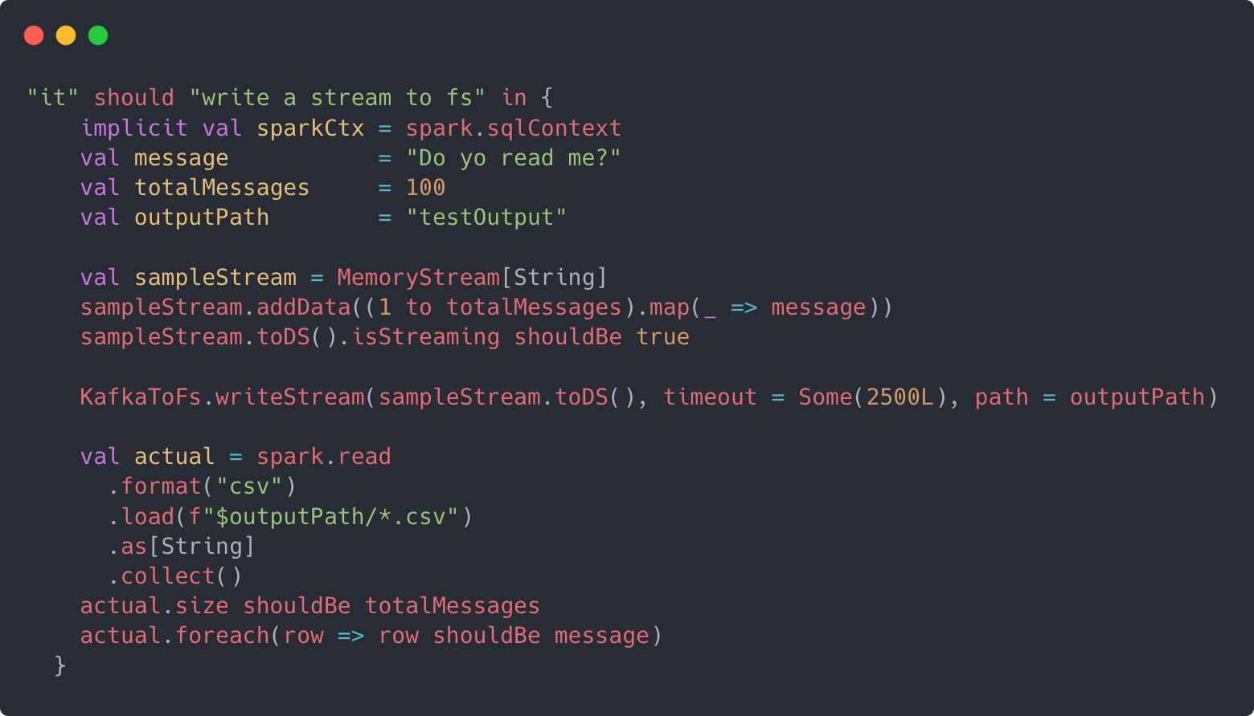
TeSTING WRITE STREAM
Only streaming Datasets can’t be written in a stream
Streaming Datasets can’t be collected, they need to be written
To test write we need to read

Slide 18

Exercise time

Slide 19
Spark structured streaming
Monitoring

Slide 20
Monitoring A STREAM
How many rows per seconds are we reading?
How much latency is procuding our system?

Slide 21
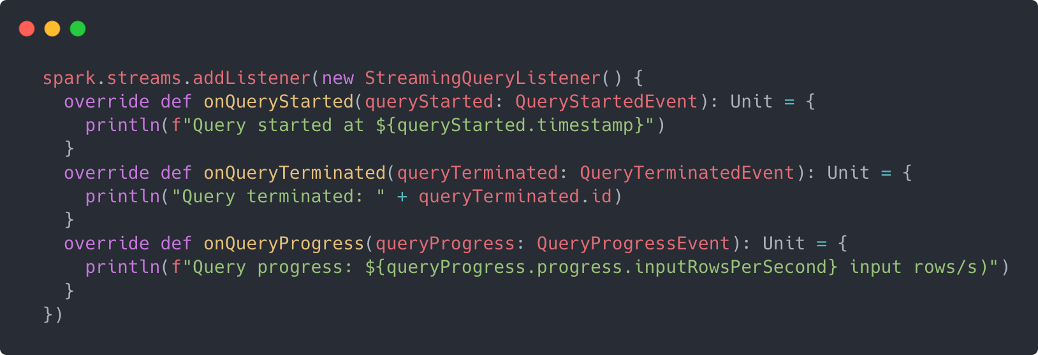
Monitoring A STREAM – Query Listeners

Slide 22
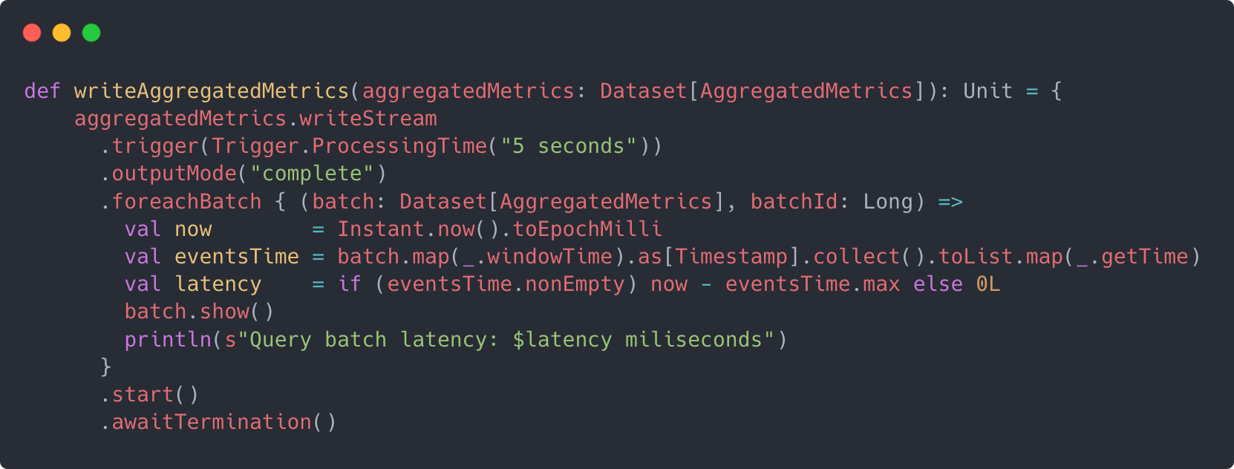
Monitoring A STREAM – Calculating latancy

